Slide 1
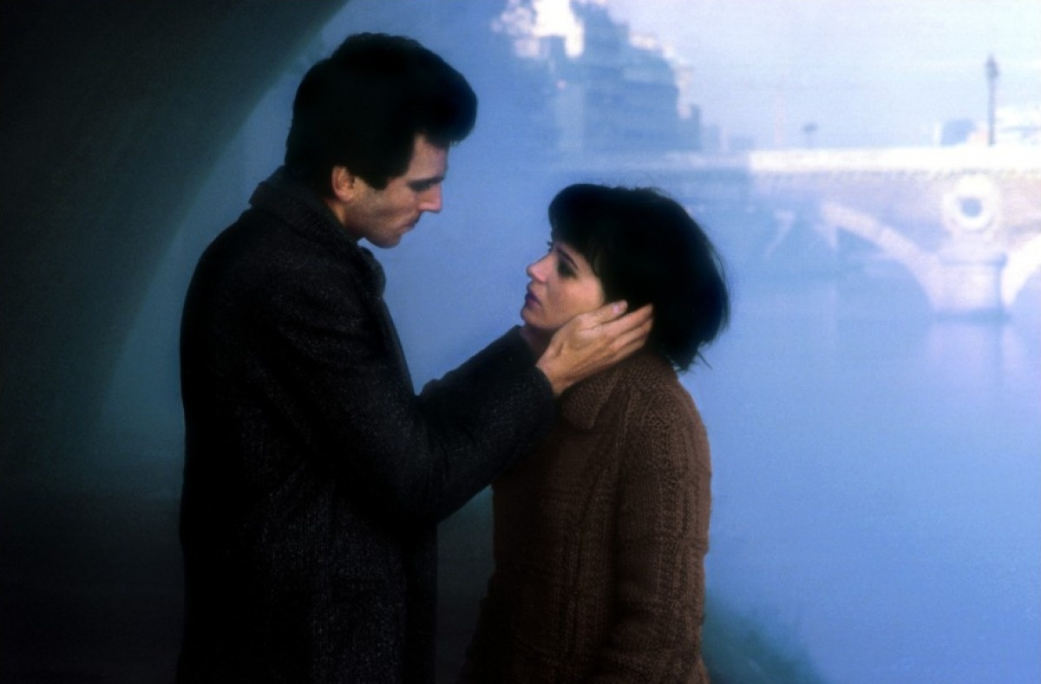

The unbearable lightness of being

Slide 2
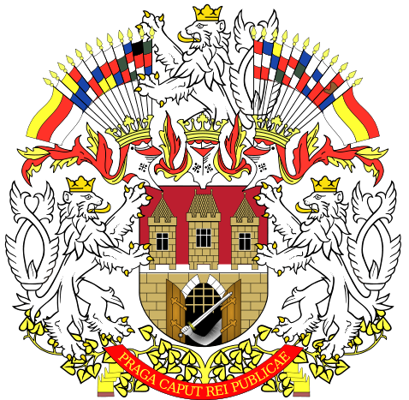
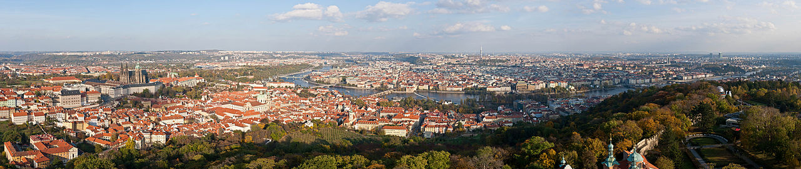
Prague
Sakauu

Slide 3
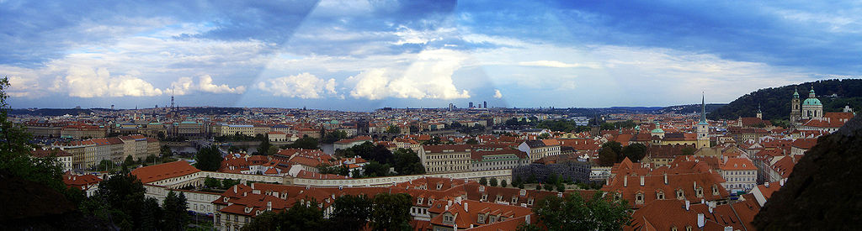
Prague
Sakauu

Slide 4
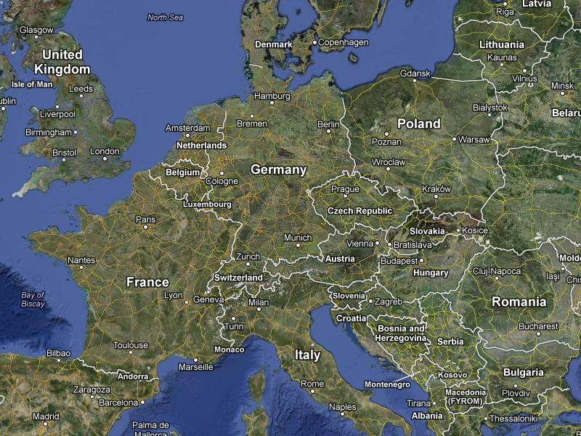
Capital of the Czech Republic

Slide 5
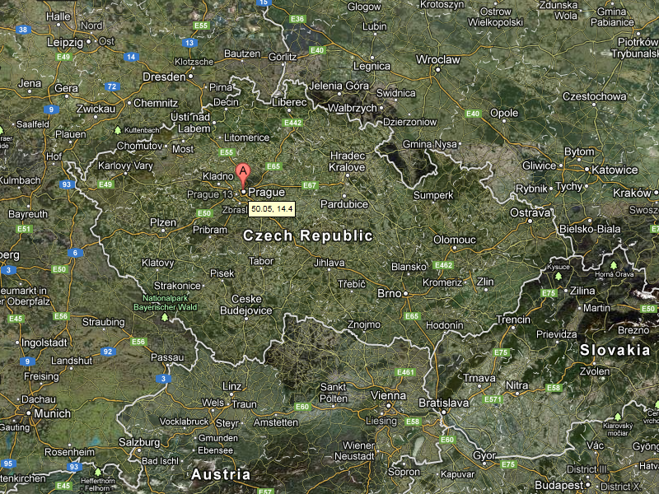
Situated in the north-west of the country on the Vltava River, at 50°05"N and 14°27"E. in the center of the Bohemian Basin.

Slide 6
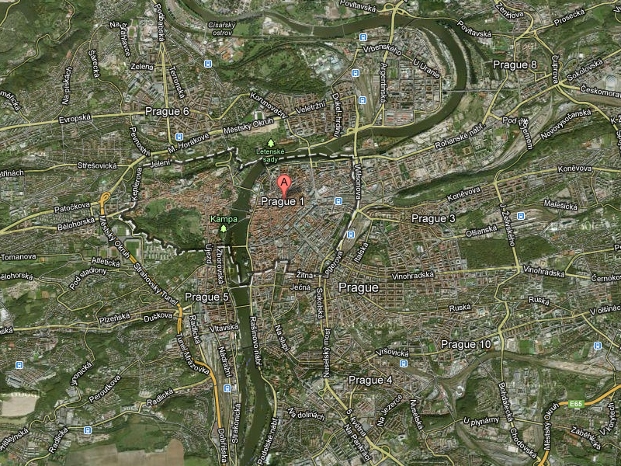
Situated on the Vltava River

Slide 7
Prague |  | Shanghai
1,262,106(2011) | Population | 23,019,148(2010)
496 km² | Area | 6,340.5 km²
9th century | Founded | 5th–7th century
Notes:
Twin town Shanghai
The city has a friendship agreement and is twinned with

Slide 8
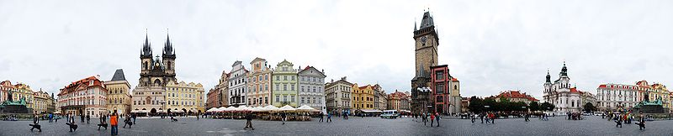
Old Town Square
Jan Hus Memorial
Notes:
The square's center is home to a statue of religious reformer Jan Hus, who for his beliefs was burned at the stake in Constance. The statue known as the Jan Hus Memorial was erected on July 6, 1915 to mark the 500th anniversary of his death. The square is also home to a memorial to martyrs (including Jan Jesenius and Maxmilián Hošťálek) beheaded on that spot after the Battle of White Mountain. Twenty-seven crosses mark the pavement in their honour. While the installation date of these crosses is uncertain, a nearby plaque which lists the names of all 27 victims dates from 1911.^{[1]}

Slide 9
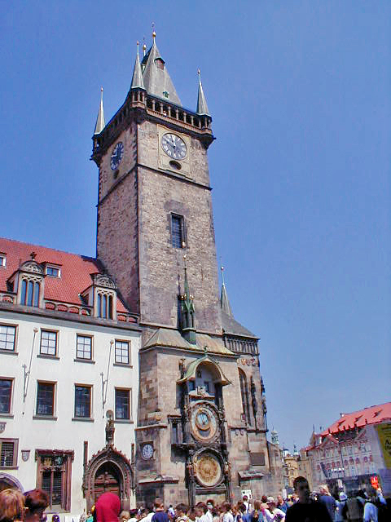
Prague
Astronomical
Clock
Astronomical dial
Animated figures
Calendar

Slide 10
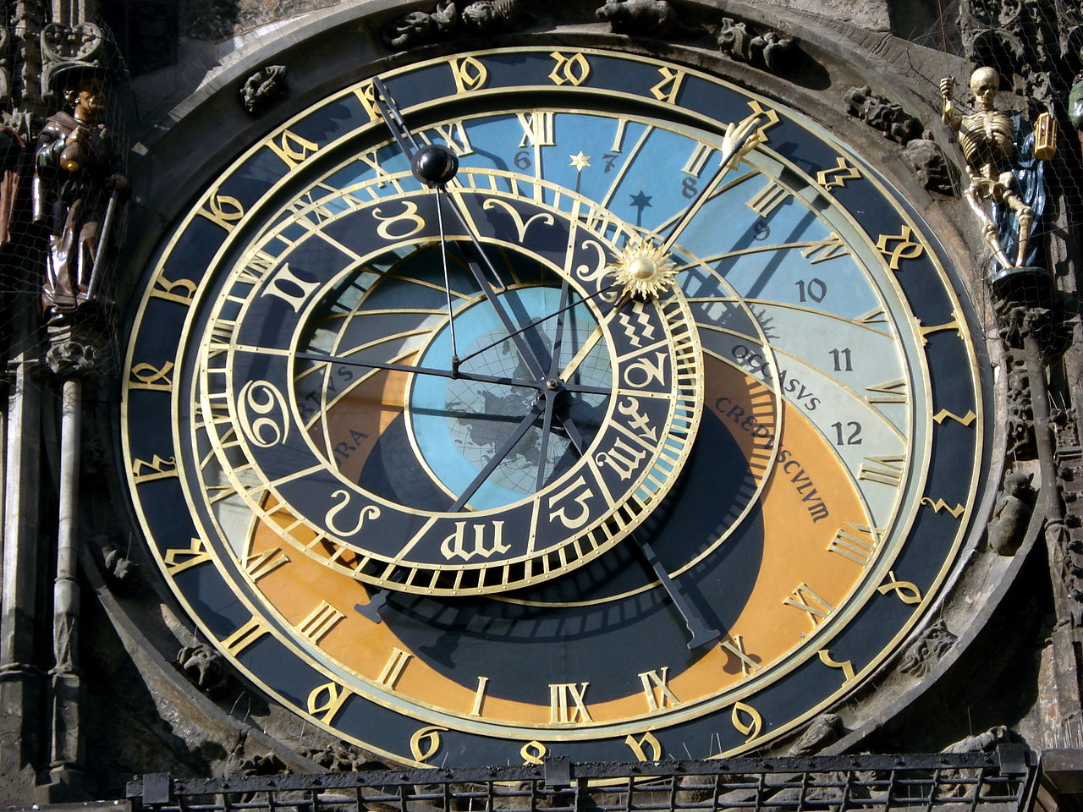
Astronomical dial

Slide 11
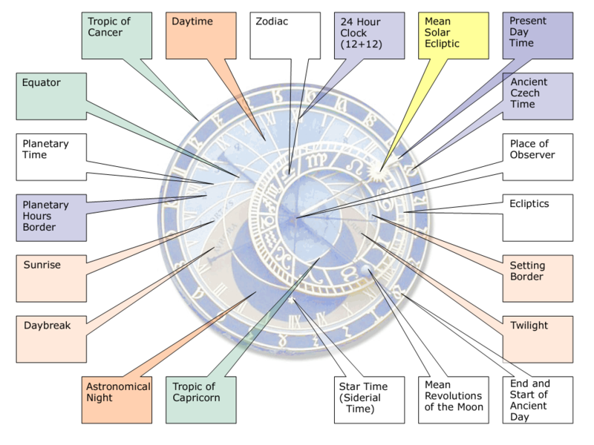

Slide 12
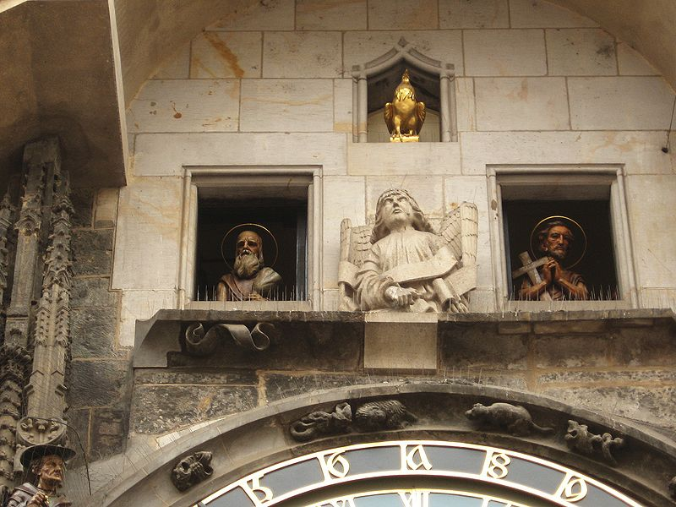
Animated figures

Slide 13
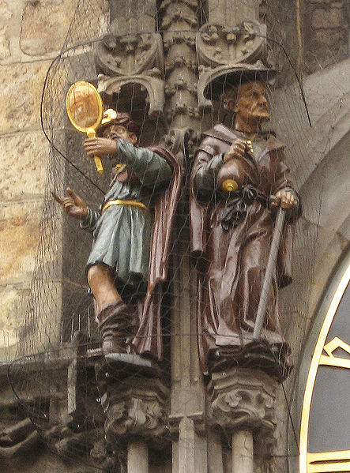
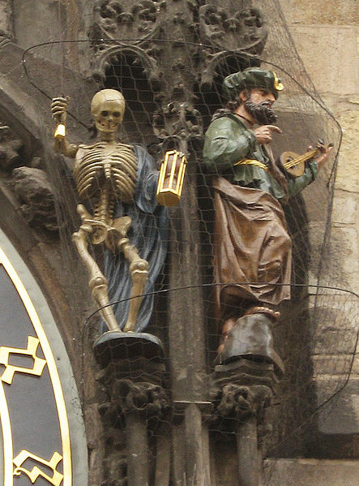
Animated figures

Slide 14
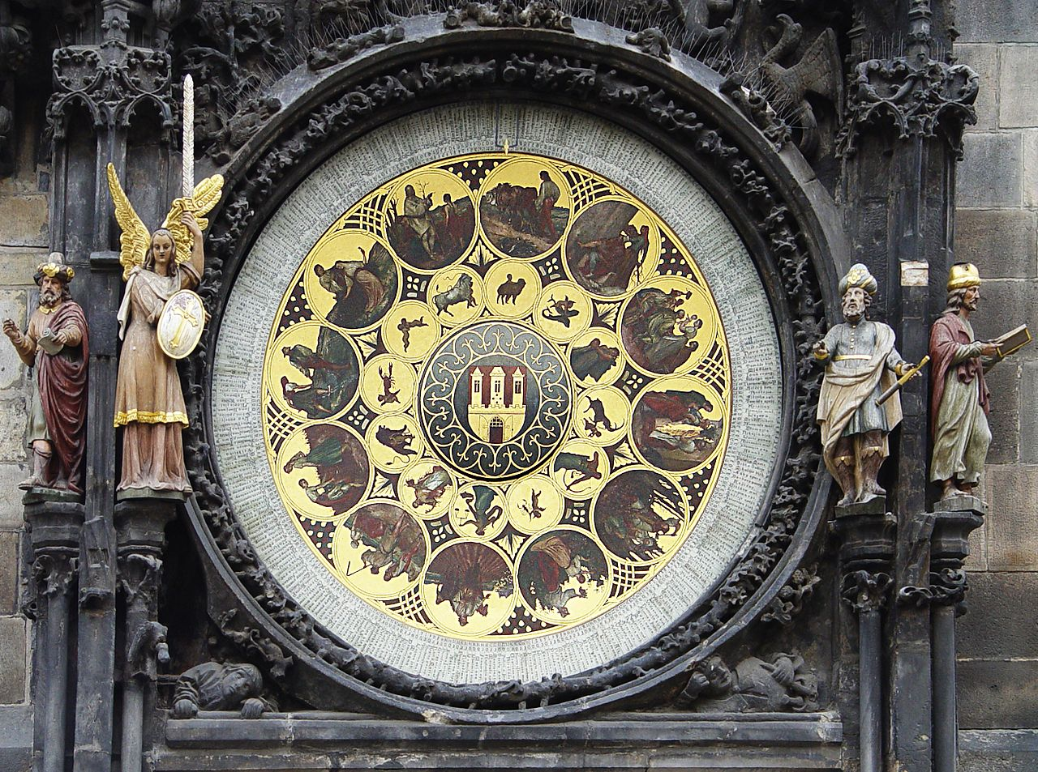
Calendar

Slide 15
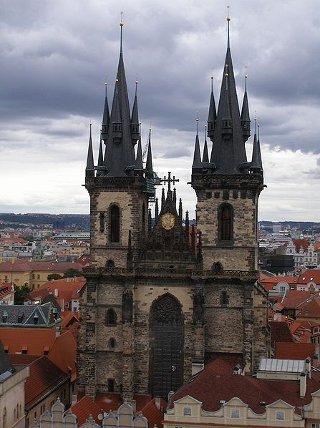
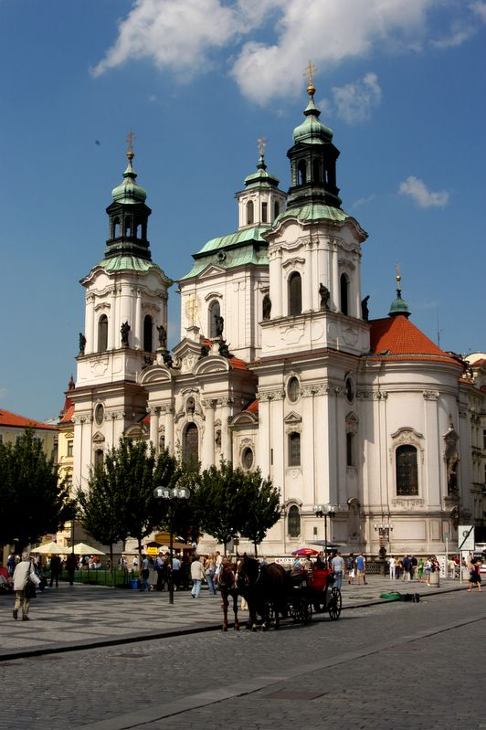
Týn Church
St. Nicholas Church
Notes:
St. Nicholas Church (baroque)
Týn Church (gothic)

Slide 16
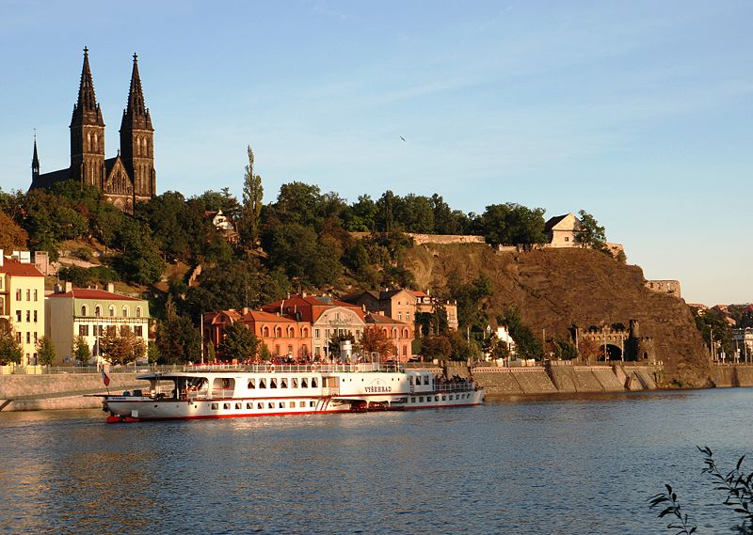
Vyšehrad
Notes:
Vyšehrad is a historical fort located in the city of Prague, Czech Republic. It was probably built in the 10th century, on a hill over the Vltava River. Situated within the castle is the Basilica of St Peter and St Paul, as well as the Vyšehrad Cemetery, containing the remains of many famous people from Czech history, among them Antonín Dvořák, Bedřich Smetana, Karel Čapek, and Alphonse Mucha. It also contains Prague's oldest surviving building, the Rotunda of St Martin from the 11th century.
Local legend holds that Vyšehrad was the location of the first settlement which later became Prague, though thus far this claim remains unsubstantiated.

Slide 17
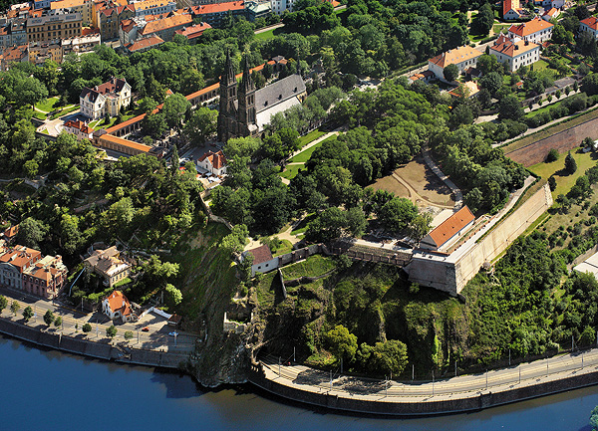
Vyšehrad

Slide 18
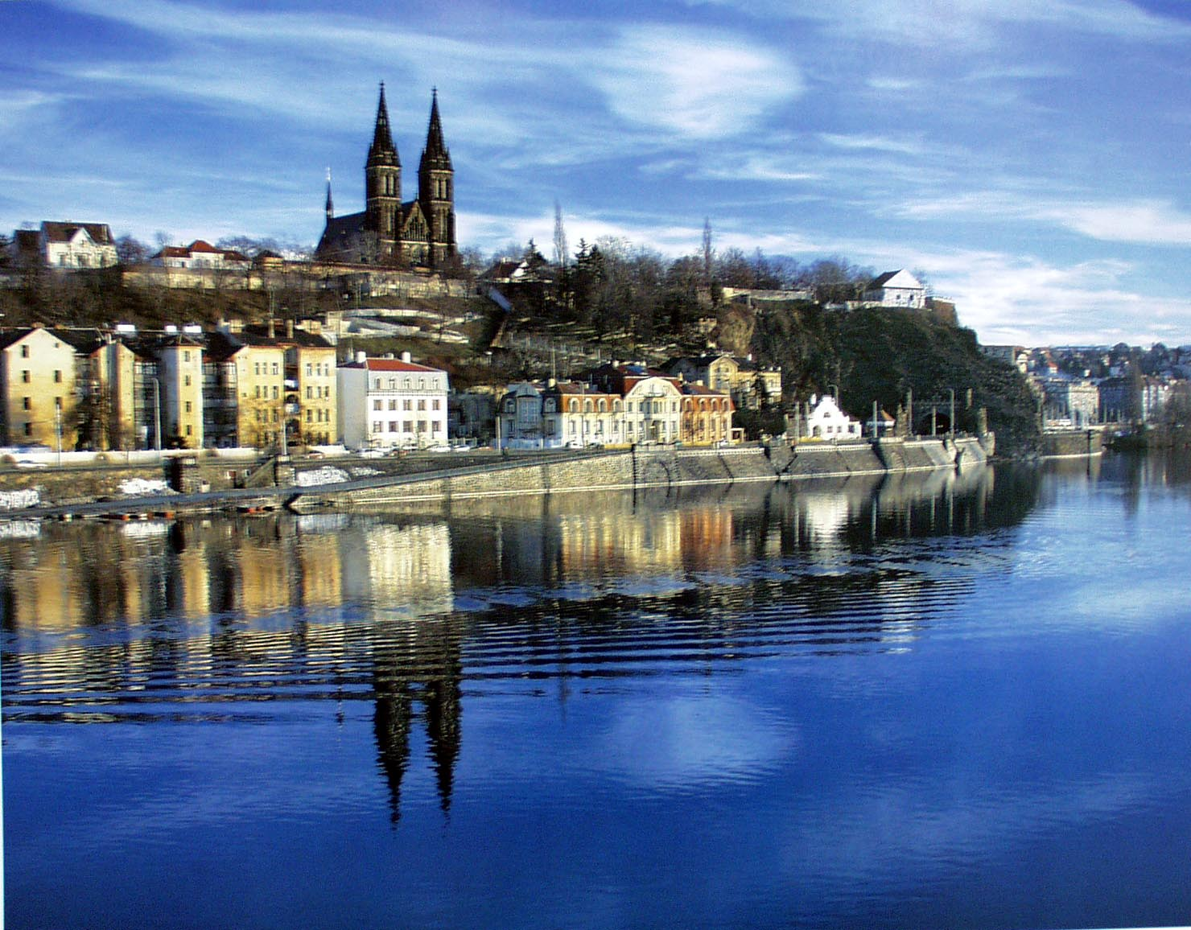


Slide 19
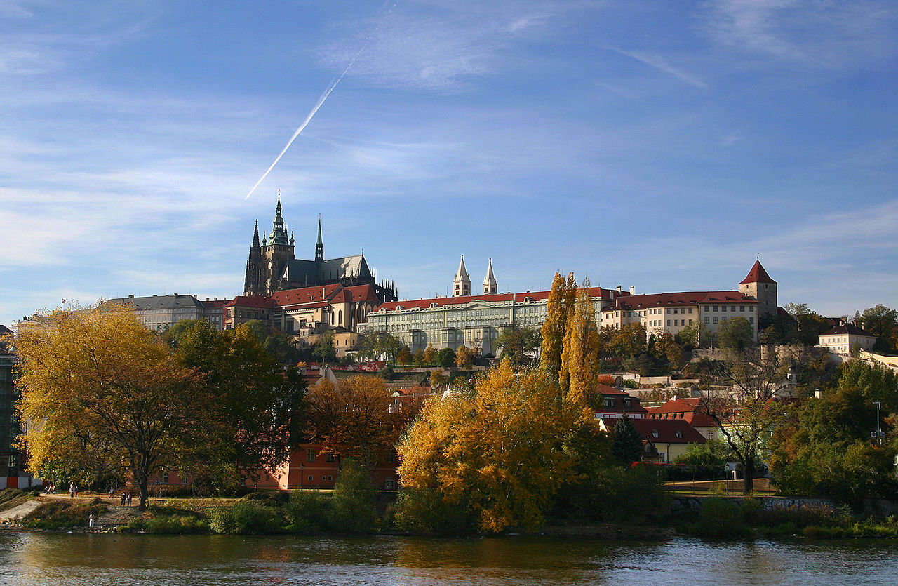
Prague Castle
Notes:
Prague Castle (Czech: Pražský hrad) is a castle in Prague where the Kings of Bohemia, Holy Roman Emperors and presidents of Czechoslovakia and the Czech Republic have had their offices. The Bohemian Crown Jewels are kept within a hidden room inside it.
According to Guinness Book of Records, Prague Castle is the largest ancient castle in the world. [1] It occupies an area of almost 70 000 m², at about 570 metres in length and an average of about 130 metres wide.

Slide 20
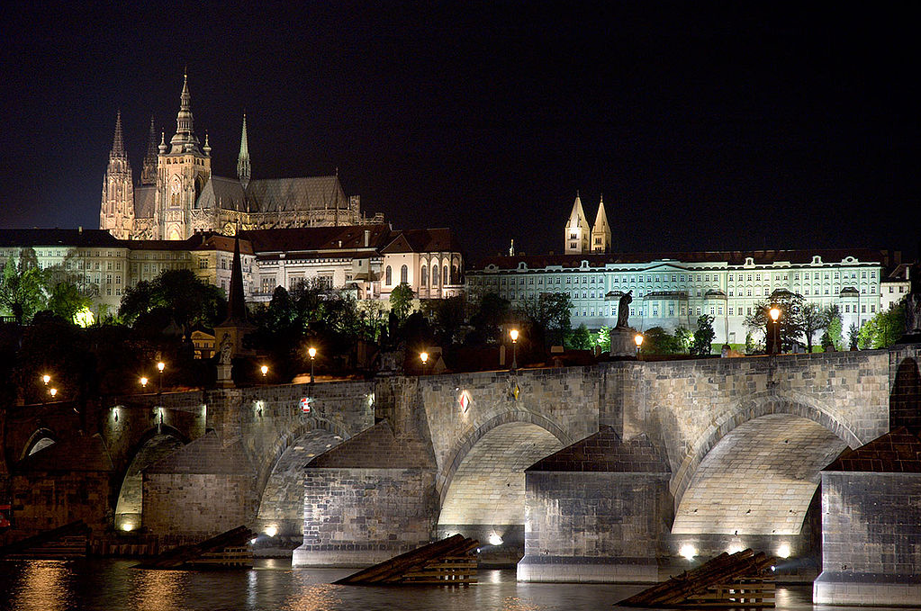
Prague Castle
Notes:
Prague Castle (Czech: Pražský hrad) is a castle in Prague where the Kings of Bohemia, Holy Roman Emperors and presidents of Czechoslovakia and the Czech Republic have had their offices. The Bohemian Crown Jewels are kept within a hidden room inside it.
According to Guinness Book of Records, Prague Castle is the largest ancient castle in the world. [1] It occupies an area of almost 70 000 m², at about 570 metres in length and an average of about 130 metres wide.

Slide 21
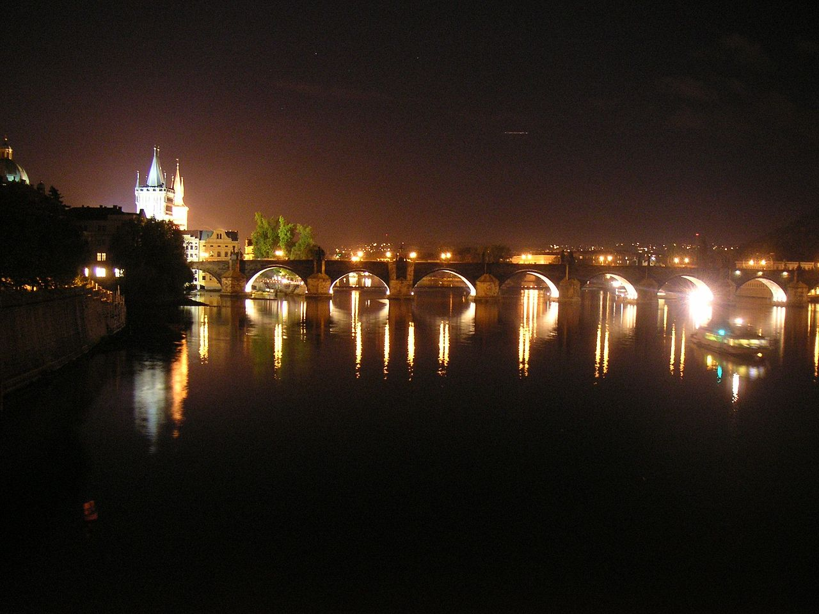
Charles Bridge
Notes:
At night Charles Bridge is a quiet place, but during the day it changes its face into a very busy venue with painters, owners of kiosks, and vendors alongside numerous tourists crossing the bridge.
The Charles Bridge (Czech: Karlův most listen (help·info)) is a famous historic bridge that crosses the Vltava river in Prague, Czech Republic. Its construction started in 1357 under the auspices of King Charles IV, and finished in the beginning of the 15th century. As the only means of crossing the river Vltava (Moldau) until 1841, the Charles Bridge was the most important connection between Prague Castle and the city's Old Town and adjacent areas. This "solid-land" connection made Prague important as a trade route between Eastern and Western Europe. The bridge was originally called the Stone Bridge (Kamenný most) or the Prague Bridge (Pražský most) but has been the "Charles Bridge" since 1870.

Slide 22
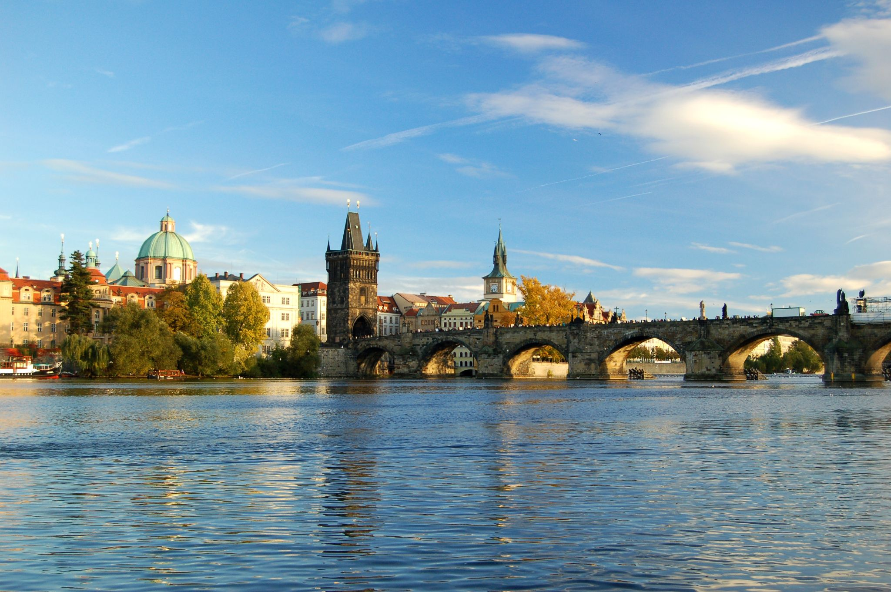
Charles Bridge

Slide 23
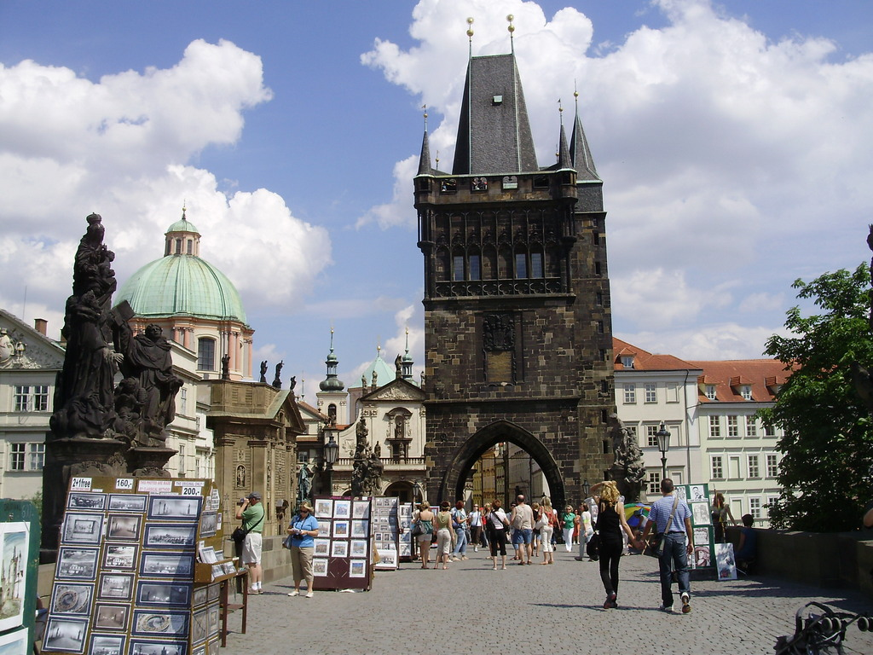
Charles Bridge

Slide 24
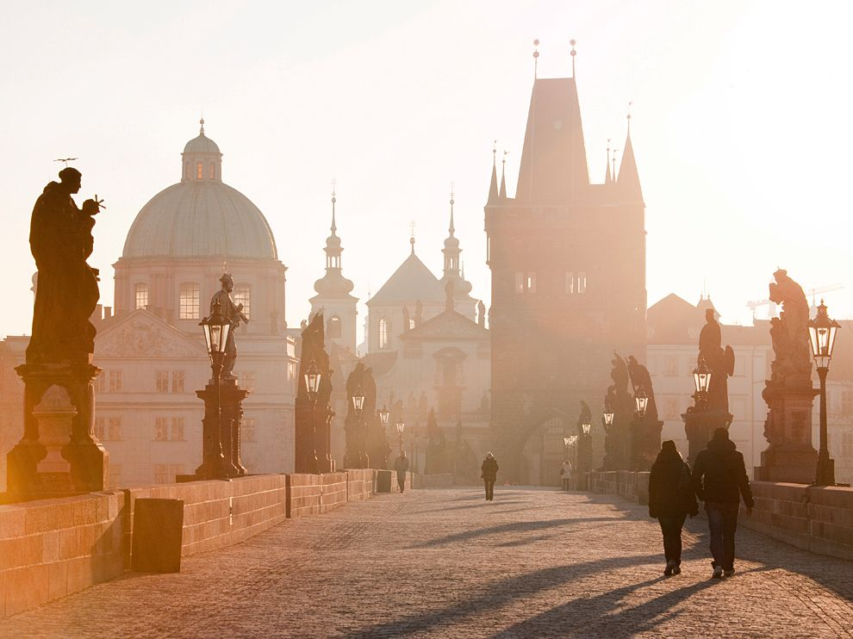
Charles Bridge

Slide 25
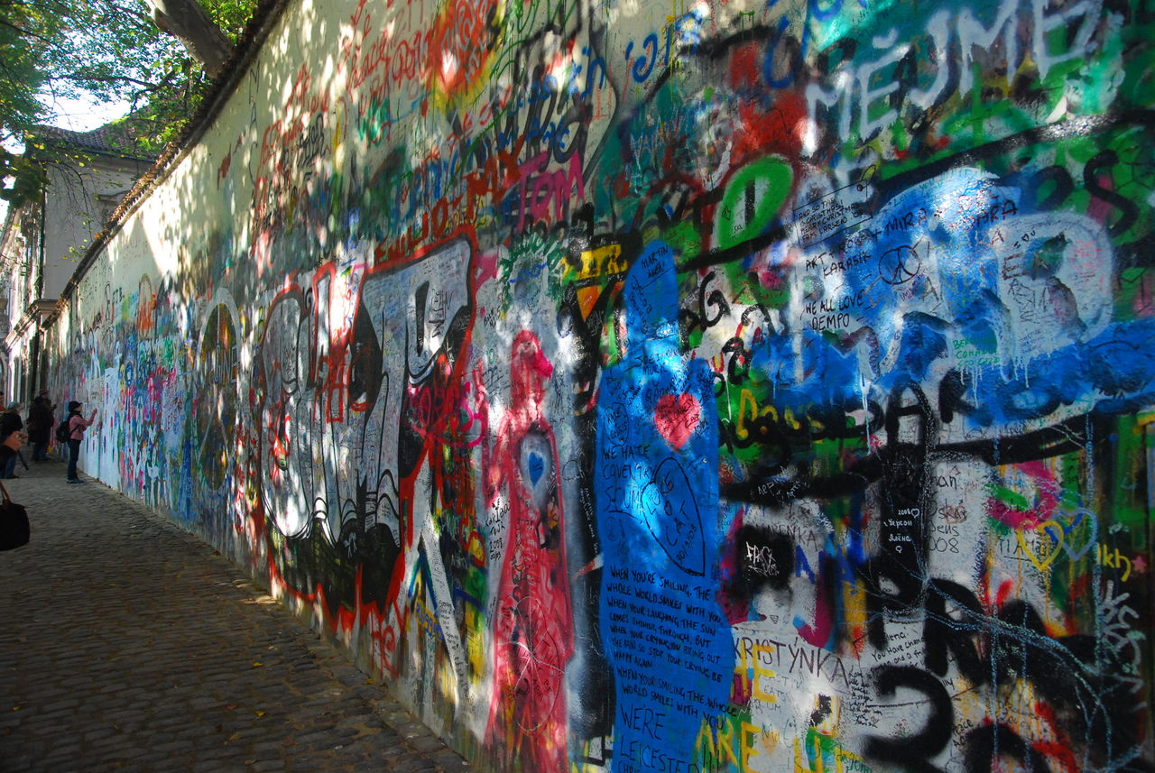
Lennon Wall
Notes:
The Lennon Wall or John Lennon Wall, is a wall in Prague, Czech Republic. Once a normal wall, since the 1980s it has been filled with John Lennon-inspired graffiti and pieces of lyrics from Beatles songs.
In 1988, the wall was a source of irritation for the communist regime of Gustáv Husák. Young Czechs would write grievances on the wall and in a report of the time this led to a clash between hundreds of students and security police on the nearby Charles Bridge. The movement these students followed was described ironically as "Lennonism" and Czech authorities described these people variously as alcoholics, mentally deranged, sociopathic, and agents of Western capitalism.
The wall continuously undergoes change and the original portrait of Lennon is long lost under layers of new paint. Even when the wall was repainted by some authorities, on the second day it was again full of poems and flowers. Today, the wall represents a symbol of youth ideals such as love and peace.
The wall is owned by the Knights of Malta, who allowed the graffiti to continue on the wall, and is located at Velkopřevorské náměstí (Grand Priory Square), Malá Strana.

Slide 26

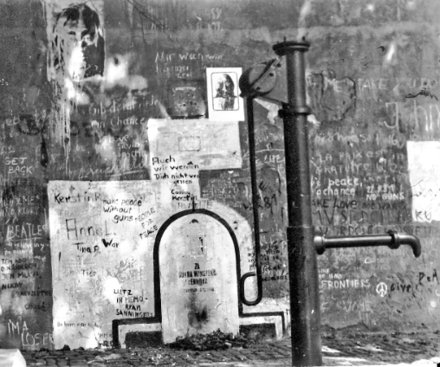
Lennon Wall in August 1981

Slide 27
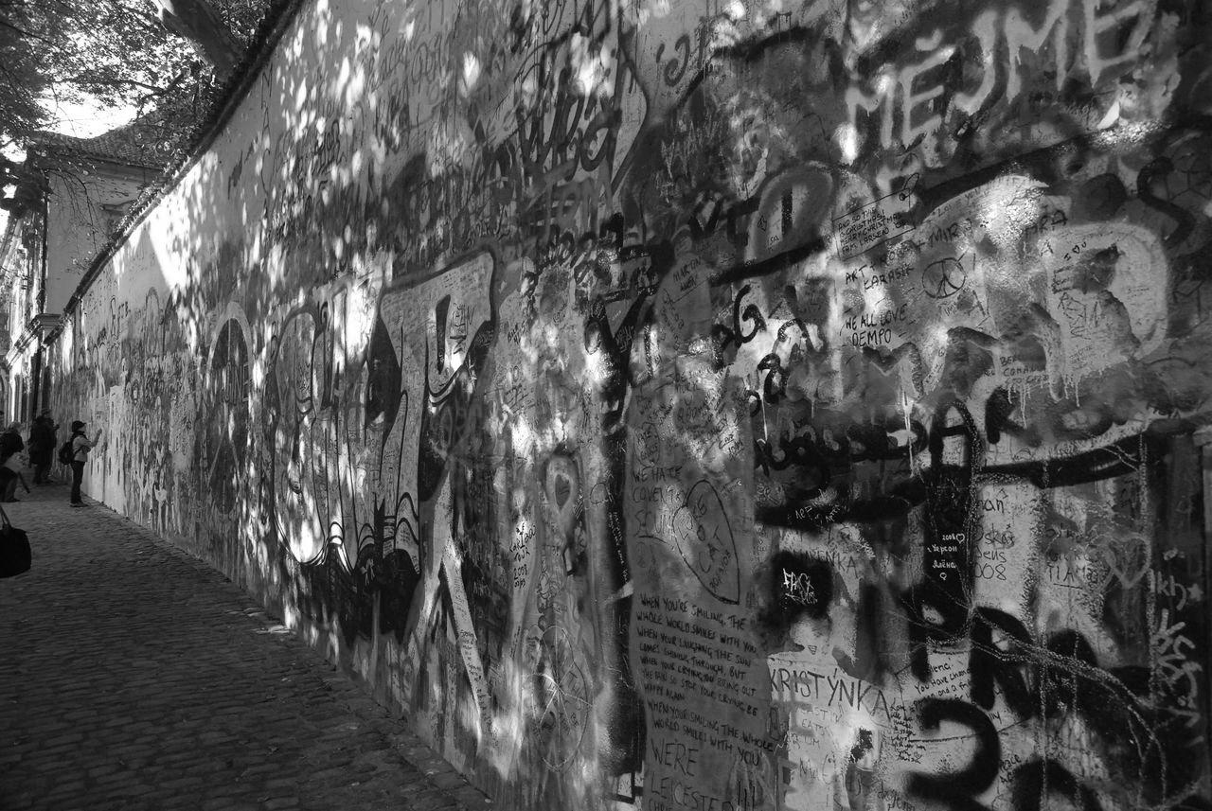
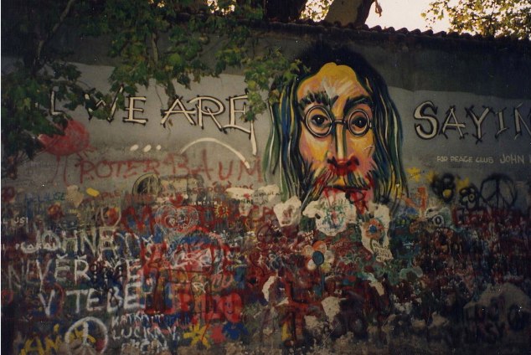
Lennon Wall ,1993

Slide 28
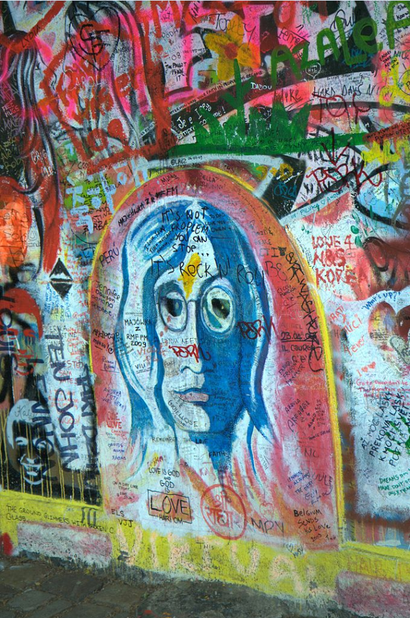
Lennon Wall
2009

Slide 29
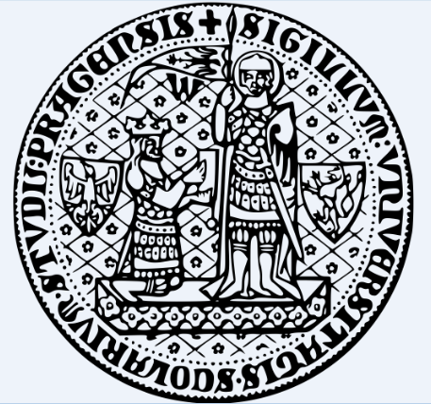
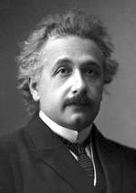
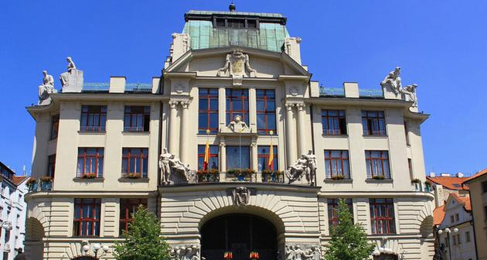
Charles University
Founded: April 7, 1348 by the Czech and Roman king Charles IV
Rank: the upper 1.5 percent of the World’s best universities

Slide 30
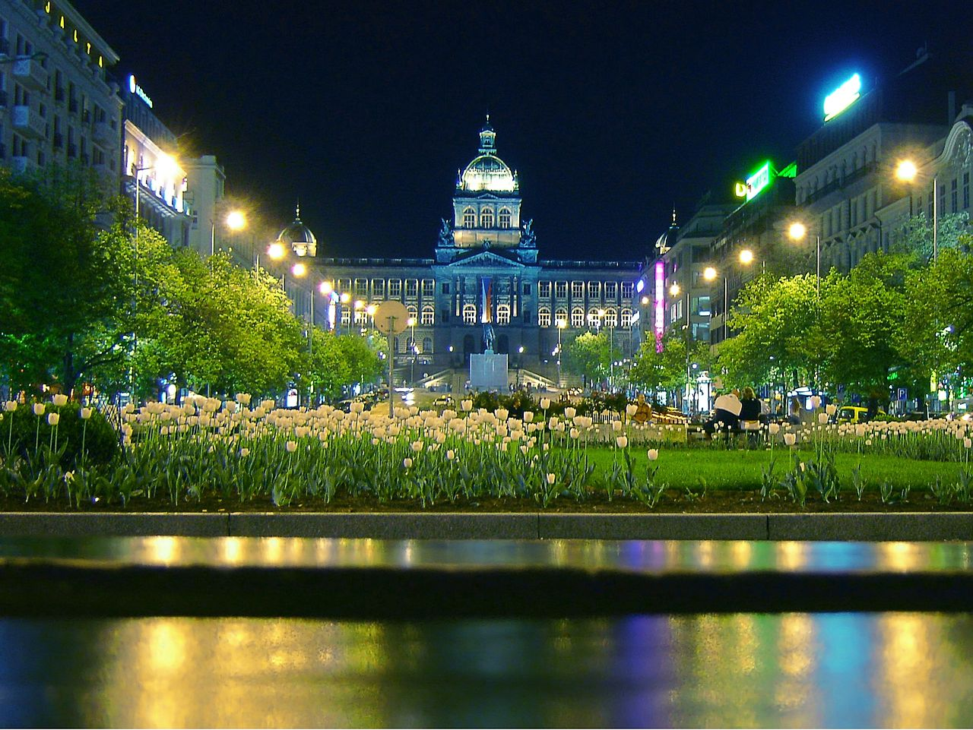
National Museum (Prague)
Notes:
The National museum (Czech: Národní muzeum) is a Czech museum institution intended to systematically establish, prepare and publicly exhibit natural scientific and historical collections. It was founded 1818 in Prague by Kašpar Maria Šternberg. Historian František Palacký was also strongly involved.
At present the National Museum houses almost 14 million items from the area of natural history, history, arts, music and librarianship, located in tens of buildings.

Slide 31
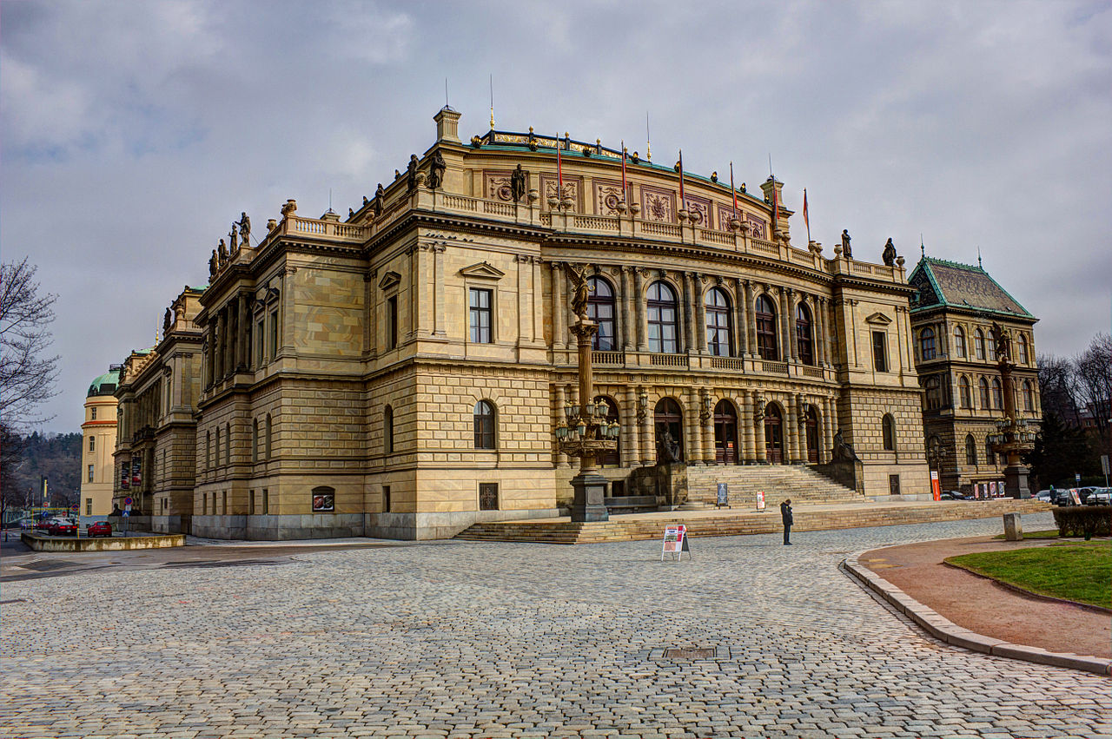
Rudolfinum

Slide 32
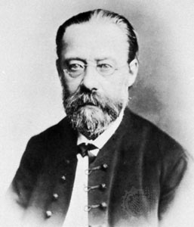
Bedřich
Smetana

Slide 33
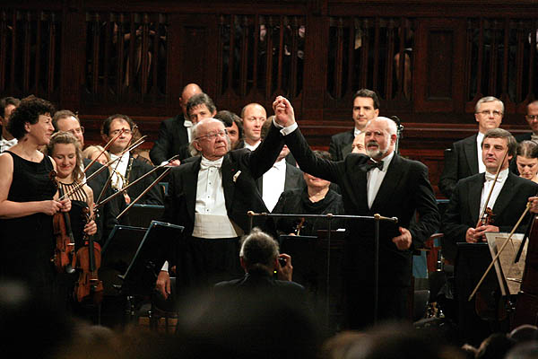
Prague Spring International Music Festival
Notes:
is a permanent showcase for outstanding performing artists, symphony orchestras and chamber music ensembles of the world.
Since 1946, May 12 every year

Slide 34
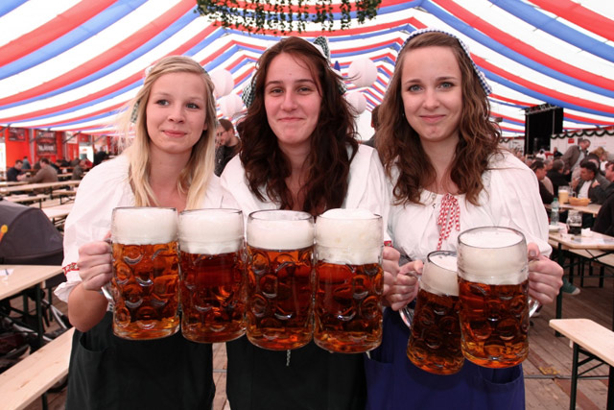
Czech Beer Festival
Notes:
Czech Beer Festival (Český pivní festival) is the biggest beer festival in the Czech Republic, held for 17 days every year in May in Prague.[1] The festival features around 120 different beers,[2] including 70 Czech brands and foreign brews from the United States or United Kingdom, with up to 10,000 seating capacity and service provide around 200 girls and boys dressed in Czech traditional costumes

Slide 35
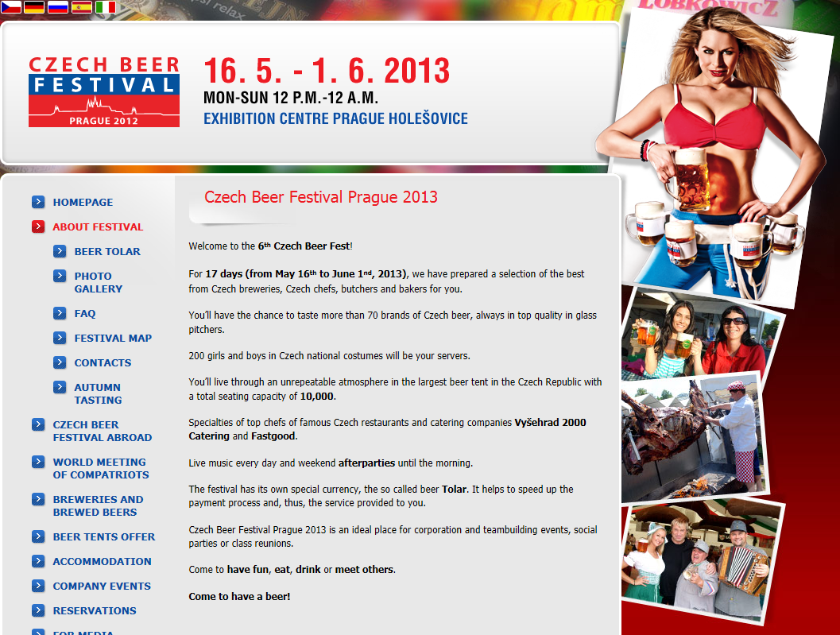
Notes:
the 6th Czech Beer Fest!
For 17 days (from May 16th to June 1nd, 2013)
You’ll have the chance to taste more than 70 brands of Czech beer, always in top quality in glass pitchers.
200 girls and boys in Czech national costumes will be your servers.

Slide 36

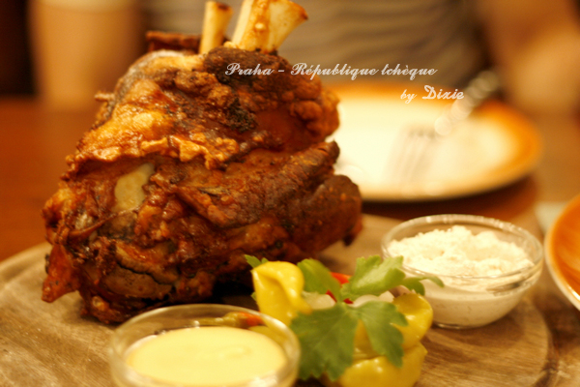
pork knee

Slide 37
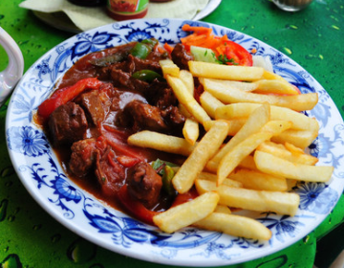
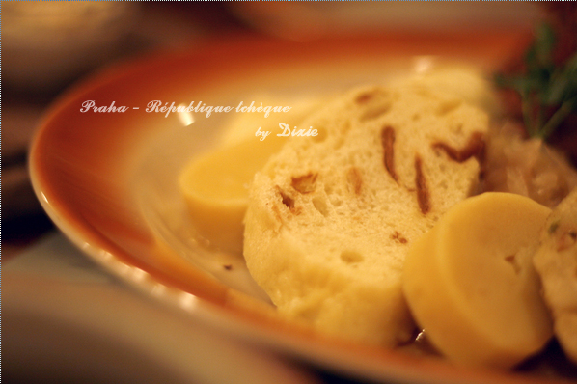
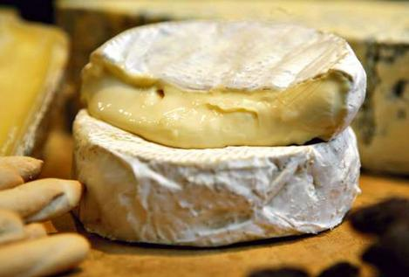
Gulas (beef)
Knediky - Czech Dumpling
hermelín

Slide 38
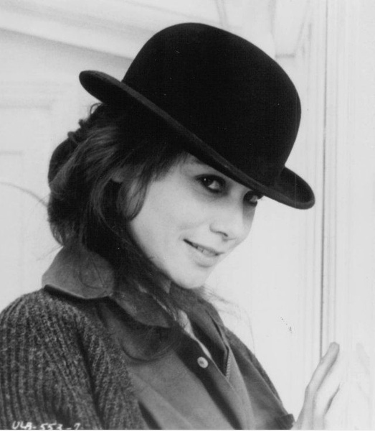
THANK YOU

